Slide 1


DEPARTMENT
COMPUTER SCIENCE AND ENGINEERING

Slide 2
Secure and Scalable EV Data Protection using RBAC and Identity-Based Cryptography
Supervisor:
Mr. G.JAYACHANDRAN M.E,
Presented by: Mohana Priya S, Surthi S, Sujitha S, Varalakshmi R,

Slide 3
Abstract:
Role-based Access Control (RBAC) offers an efficient method for managing authorization to resources, such as electric vehicle (EV) data stored in the cloud. In this context, the access control system must ensure both strong security and efficiency, particularly with regard to EV user authentication. Authentication serves as a crucial prerequisite for access control, ensuring only legitimate users can access sensitive EV data. To enhance the security and scalability of the system, this work integrates identity-based cryptography (IBC) with RBAC. IBC is used to securely authenticate EV users, ensuring that their identity is tied to their role in the system. Each EV user’s authentication is coupled with a unique identity, which is also used in the key exchange process. This combination of RBAC and IBC ensures that access to the cloud-based EV data is tightly controlled. By linking users’ roles with their identities, the system can effectively manage access permissions based on both their role and verified identity, enhancing security and streamlining the management of user access. This approach offers a robust and scalable solution for EV data protection.

Slide 4
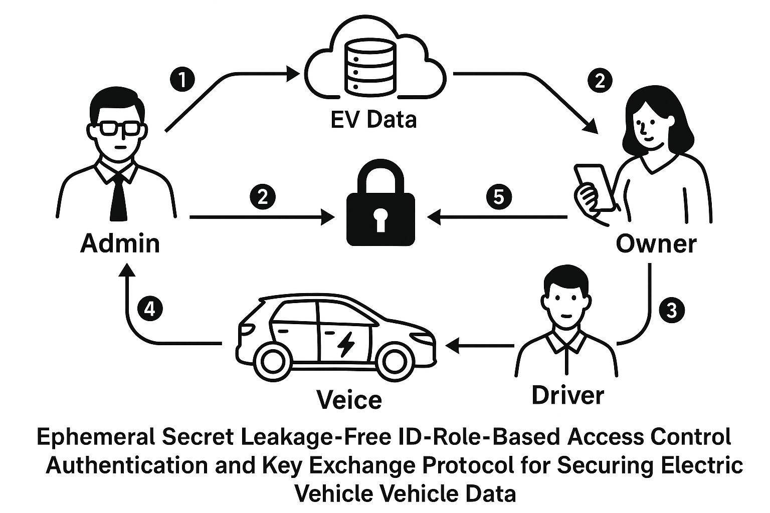

Slide 5
Literature Survey:
Overview of existing works in RBAC and IBC.
Challenges with traditional RBAC: weak identity linkage, inefficient real-time access.
Research that led to hybrid access control models in cloud systems.
References to IEEE papers on EV data security, cryptographic access models.

Slide 6
Existing System:
Uses only RBAC based on NIST standards.
Issues: Complex logins, weak identity verification, delays in real-time access, prone to unauthorized access.

Slide 7
Why This Project Matters to Humans ?
EVs store personal, location, and usage data
Risks of data theft, unauthorized access, and surveillance
Humans need control, privacy, and accountability in smart mobility systems

Slide 8
Proposed System:
Role-Based Access Control (RBAC): Assigns roles (Owner, Driver) to define permissions.
Identity-Based Cryptography (IBC): Generates a unique private key per user (sent via email) for secure login.
One-Time Password (OTP): Adds extra security for owners when accessing sensitive vehicle data.
Key Points:
Owners can:
Add/view vehicles
See associated drivers
Use OTP for secure data access
Drivers can:
Authenticate with private keys
Access data based on their role
This system ensures strong authentication, simplified EV data handling, and robust security for both owners and drivers.

Slide 9
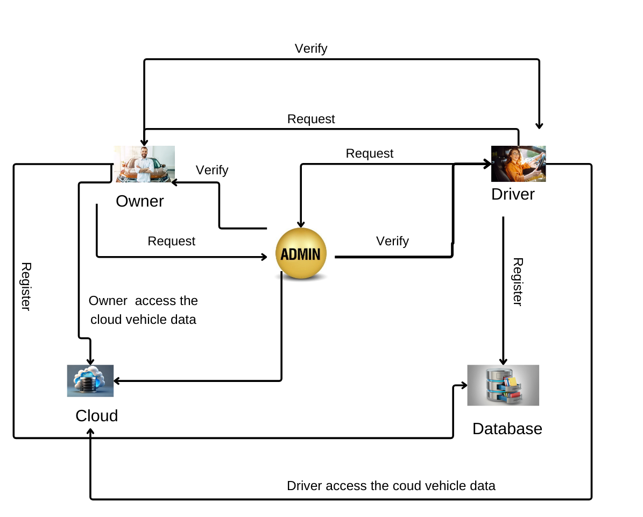
Architecture Diagram:

Slide 10
System Architecture:
Clearly defined 5 components:
Authentication & Key Generation (IBC + OTP)
2.Admin Module
3.Owner Module
4.Driver Module
5.OTP Verification

Slide 11
Main Modules:
Admin Module
Owner Module
Driver Module

Slide 12
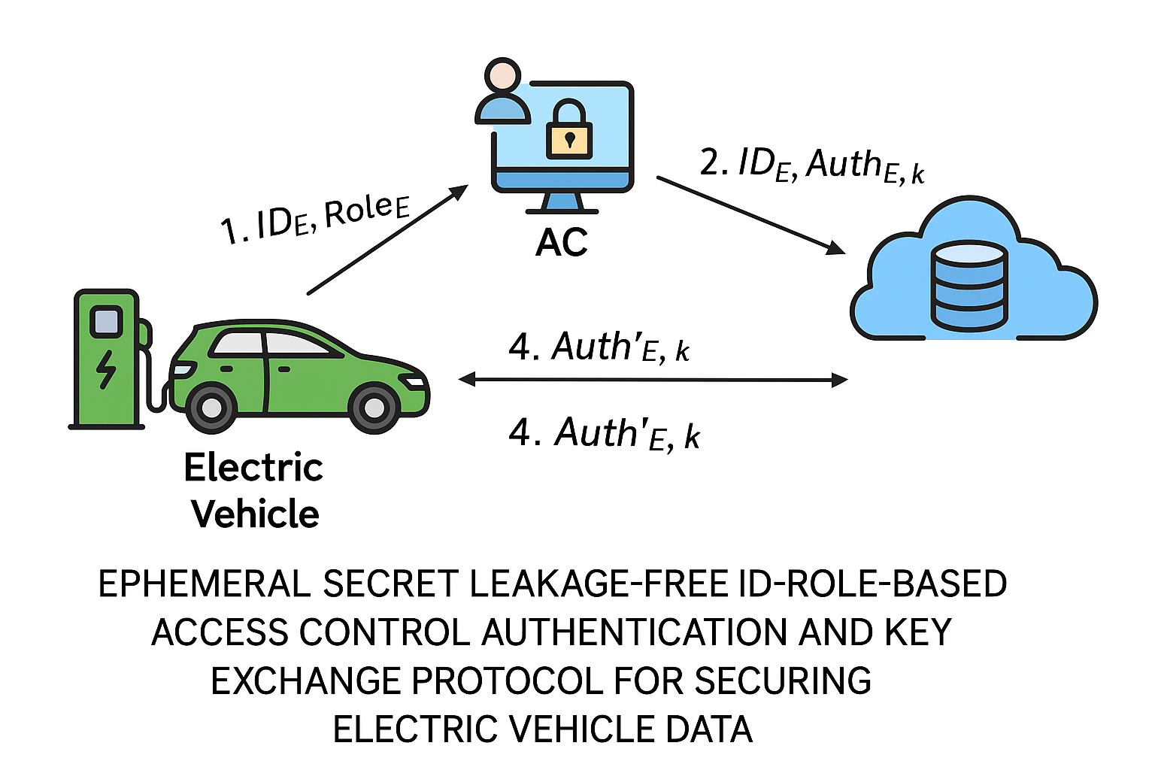

Slide 13
Admin Module:
Secure login
Add/verify users and vehicles
Assign roles

Slide 14
What it does in simple terms:
Secure Login: Admins must log in securely to use the system.
Add Vehicle Details: Admins can enter and save information about vehicles to the cloud (online storage), so it can be accessed anytime.
Verify Users: Admins can check and confirm who the vehicle owners and drivers are, making sure only the right people can see or use the data.
Assign Roles and Permissions: Admins give different levels of access to users, depending on their job. For example, a driver may only see driving data, while a manager may see reports.
Improve Security and Management: This module helps keep the system organized, secure, and easy to manage.

Slide 15
Owner Module:
The Owner Module allows EV owners to:
Securely access vehicle data using a private key
View detailed vehicle and associated driver information
Add new vehicles with ease
Maintain up-to-date and protected records
This module ensures efficient and secure management of EV ownership.

Slide 16
What it does:
Secure Access with Private Key: Owners receive a private key by email, which they use to log in securely.
View Vehicle Details: Owners can see all the important information about their vehicles (like model, number, etc.).
View Driver Details: Owners can also see who is driving their vehicle and manage those driver details.
Add New Vehicles: If the owner gets a new vehicle, they can easily add it to their profile.
User-Friendly Design: The system is simple to use, so owners can quickly update or check their information.
Keeps Data Safe: All personal and vehicle information is protected using strong security methods.

Slide 17
Driver Module:
The Driver Management Module enables:
Driver registration with verified personal information
Secure login using credentials
Access to specific electric vehicle data based on roles
This ensures authenticated and role-based access to EV information.

Slide 18
Here's what it does:
1.Driver Registration: Drivers create an account by entering their personal details. This helps verify their identity.
2. Secure Login: After registration, drivers can log in safely using their credentials (username and password).
3. Access to EV Data:
Once logged in, drivers can view only the electric vehicle data that is meant for them.
4. Safe and Easy to Use: The system makes it simple for drivers to get the information they need while keeping everything secure.

Slide 19
Future enhancement
Future enhancements of the EV data management system include:
Adding biometric authentication (fingerprint, facial recognition) for
stronger security
Launching a mobile app with real-time notifications and vehicle
updates
These upgrades aim to improve security, usability, and user engagement.

Slide 20
✅ Technology Stack:
Backend: Java Spring Boot
Frontend: Thymeleaf, HTML, CSS, JS, jQuery
Database: MySQL
Security: Identity-Based Cryptography (simulated), OTP via email

Slide 21
Hardware Requirements
Hard Disk : 250GB and Above
RAM : 6GB and Above
Processor : i3 and Above

Slide 22
Software Requirements:
Windows 10 and above
JDK 11.0
J2EE
MySQL8

Slide 23
Output Screenshots

Slide 24
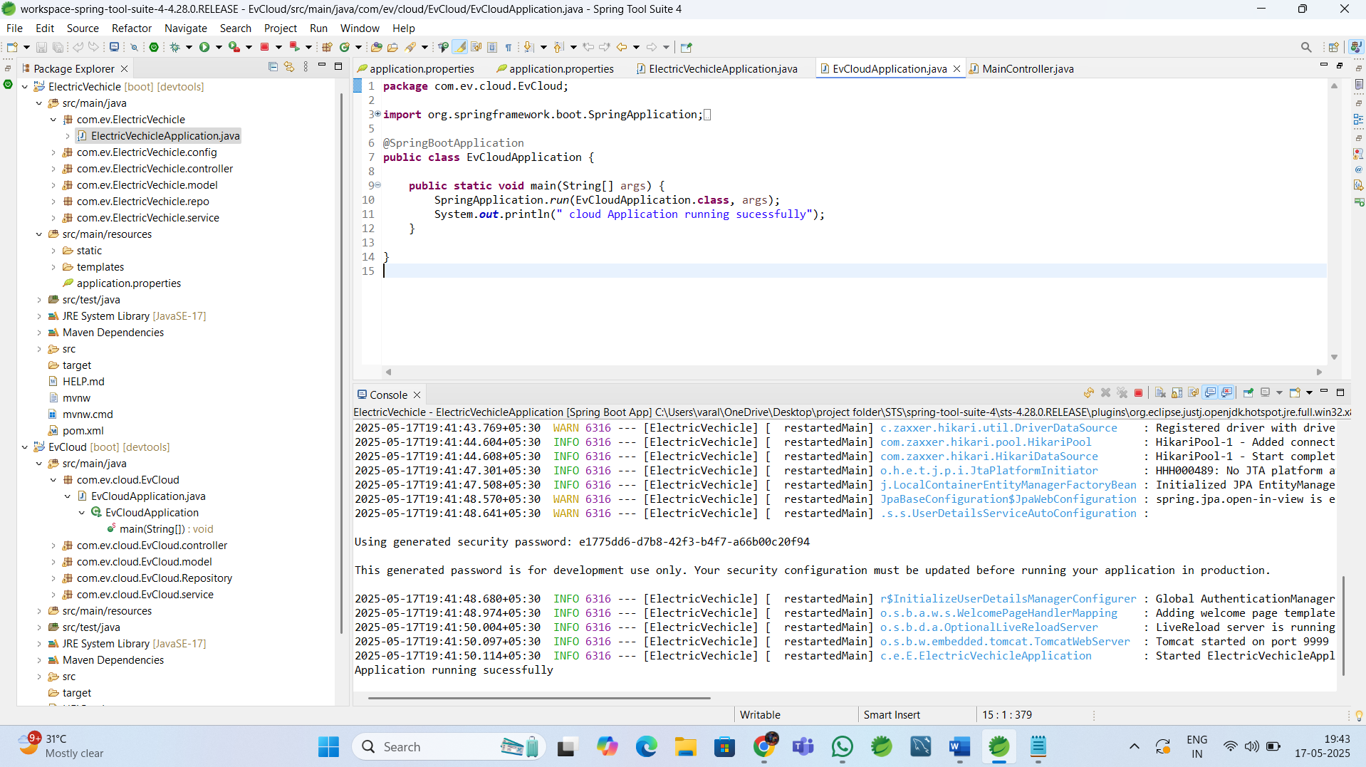
Application Running Process:

Slide 25
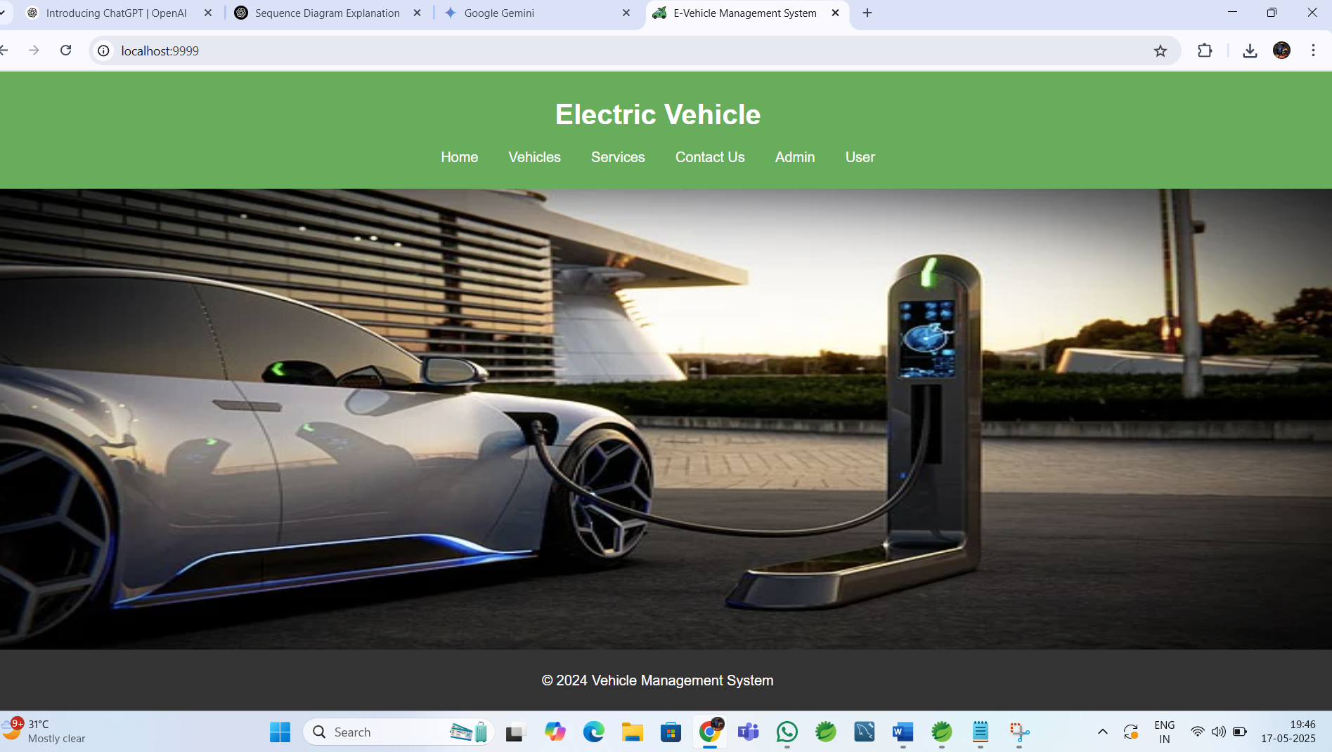
Home Page:

Slide 26
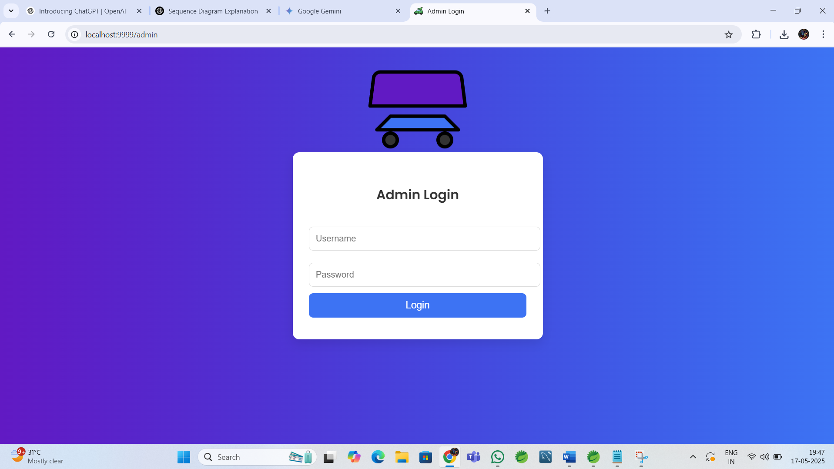
👨‍💼 2. Admin Login

Slide 27
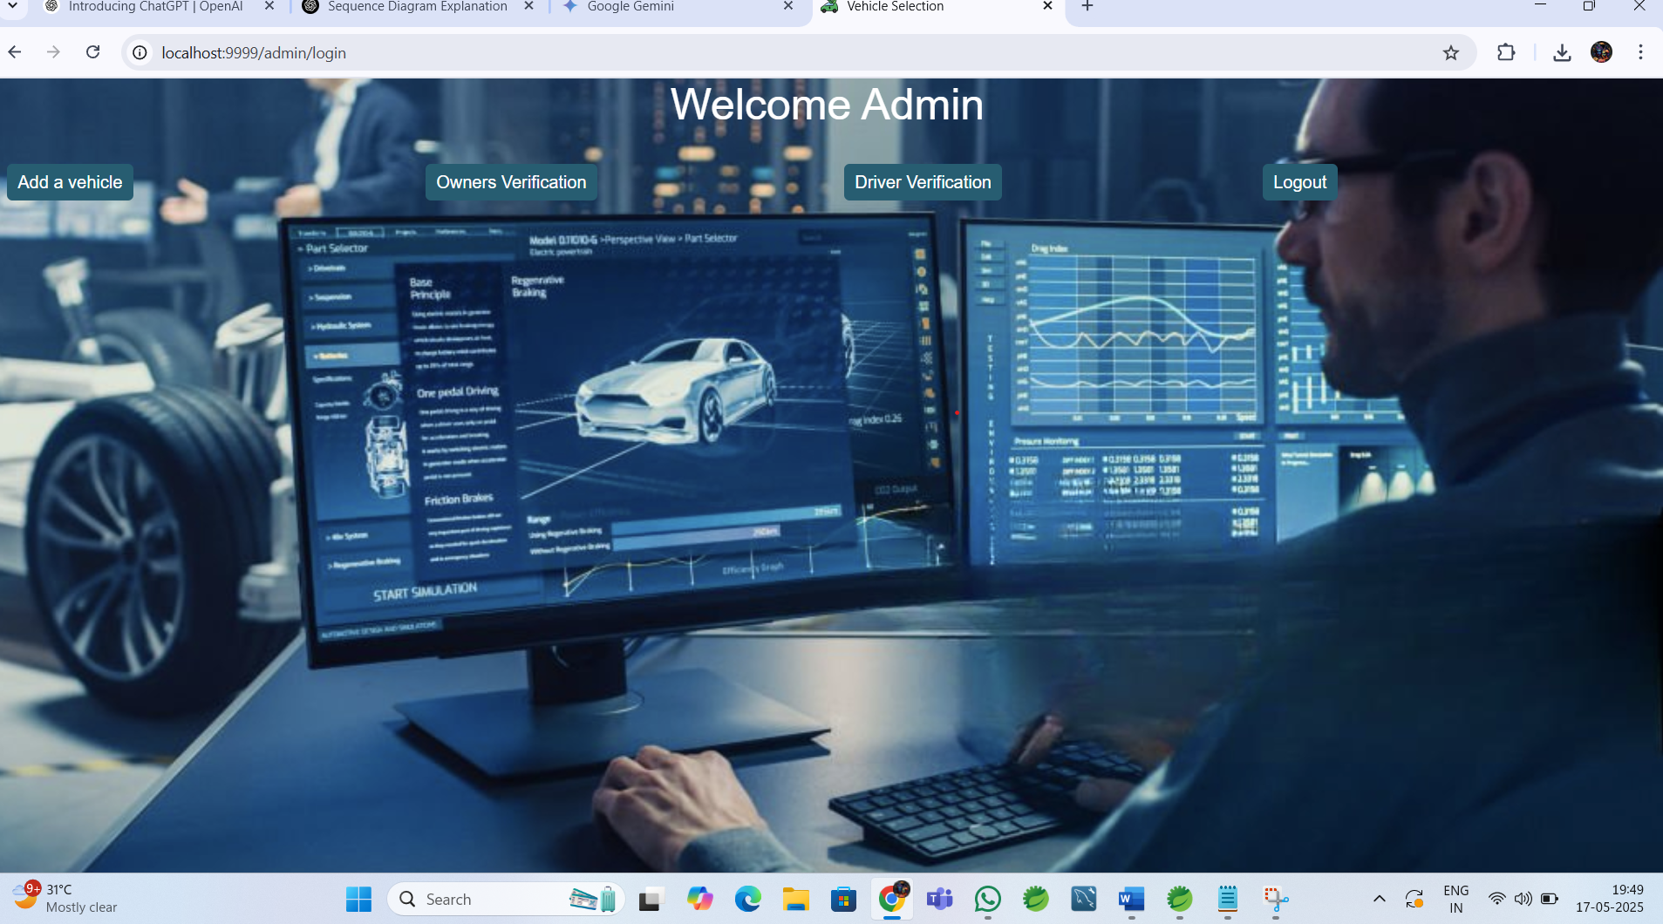
Admin Verification:

Slide 28
🚗 3. Owner Module
Login using private key
View vehicle & driver details
OTP verification for sensitive data

Slide 29
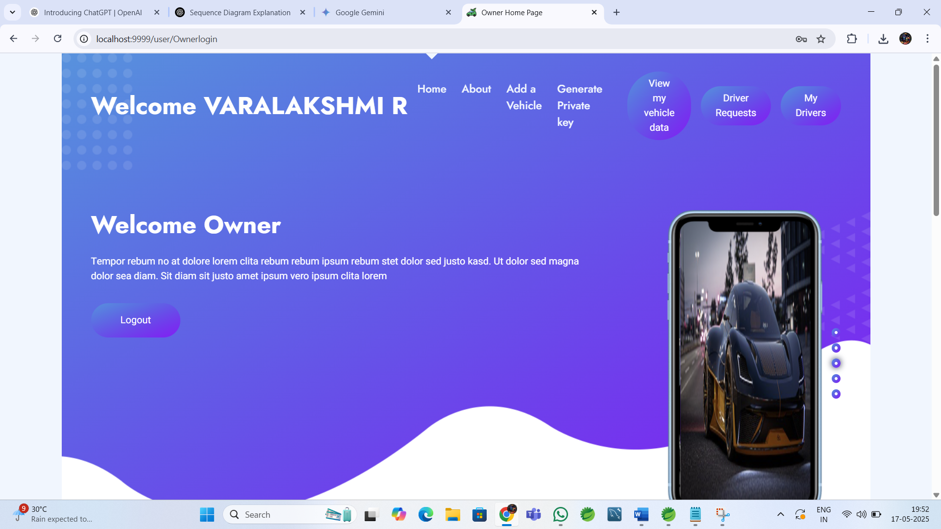

Slide 30
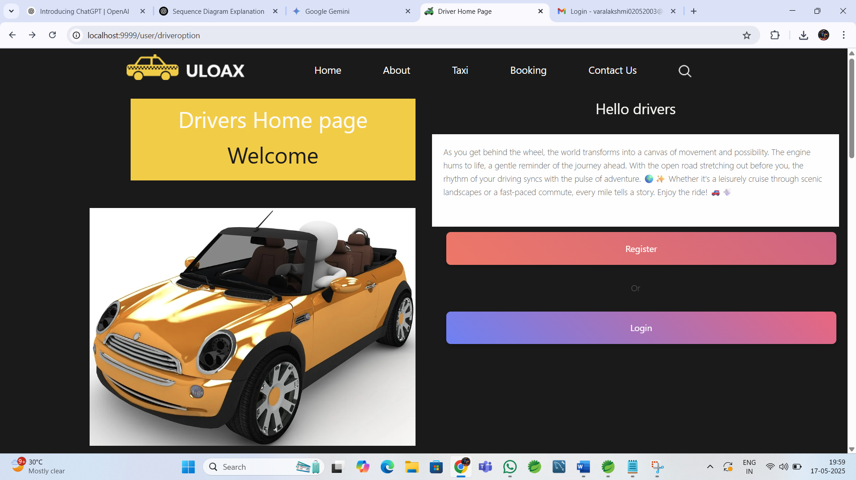
🚘 4. Driver Module Register and view assigned vehicles

Slide 31
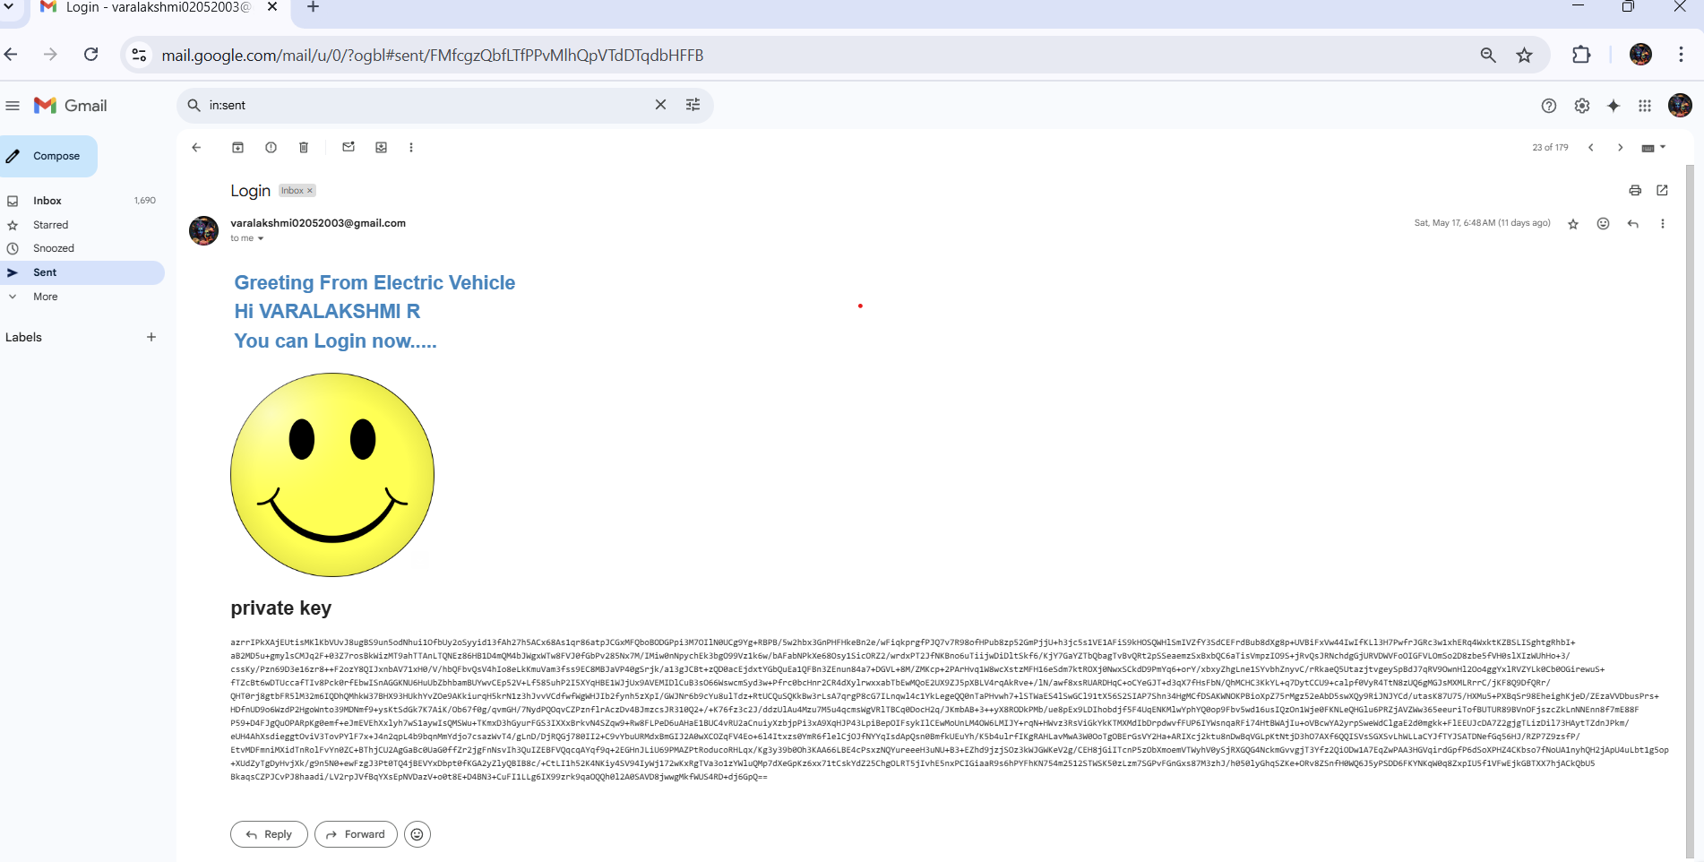
🛡️ 5. OTP Verification :

Slide 32
🧱 Database Tables (Entities):
User(id, email, role, privateKey, verified)
Vehicle(id,ownerID,details)
Dtiver(id,email,vechicleID,privateKey)
OTP (optional:session-based)

Slide 33
Conclusion:
The enhanced system improves authentication, simplifies access, and provides stronger security for EV data.
Owners and drivers benefit from a user-friendly interface with OTP and identity-based logins.
Better privacy and accountability in EV data management.

